Slide 1

By Rahul Kumar Chatterjee
Business Analyst Career Program - Capstone Project

Slide 2

Agenda
Data Exploration
Statistical Analysis using Excel
Graphical Analysis using Excel
Insert the given data into the SQL server
Import the Data from the SQL Database into PowerBI
Interactive Dashboard by using visualization tools
Conclusion and Inferences
Endnotes

Slide 3
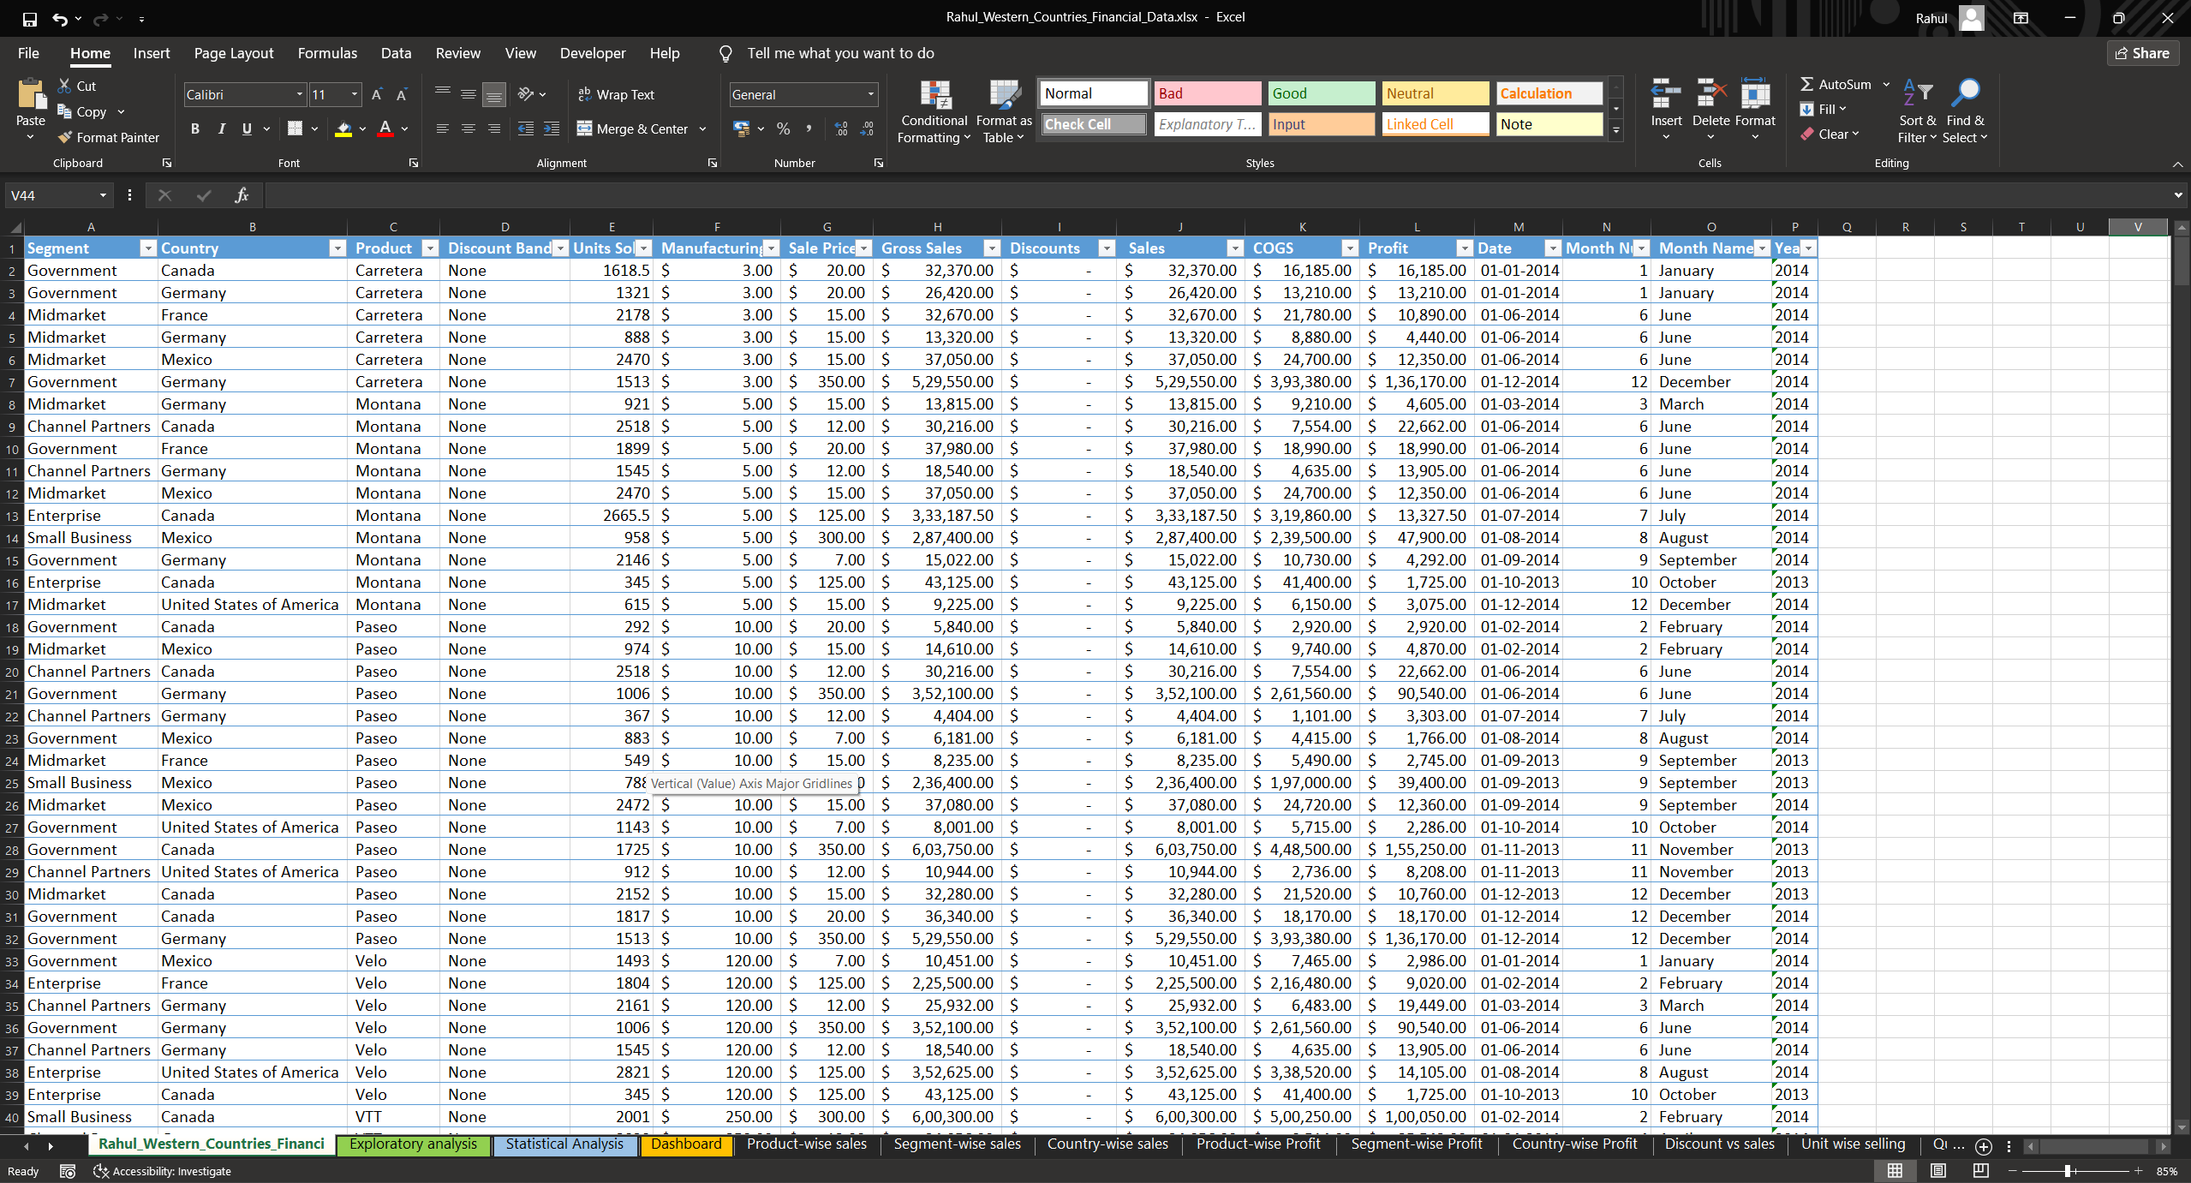
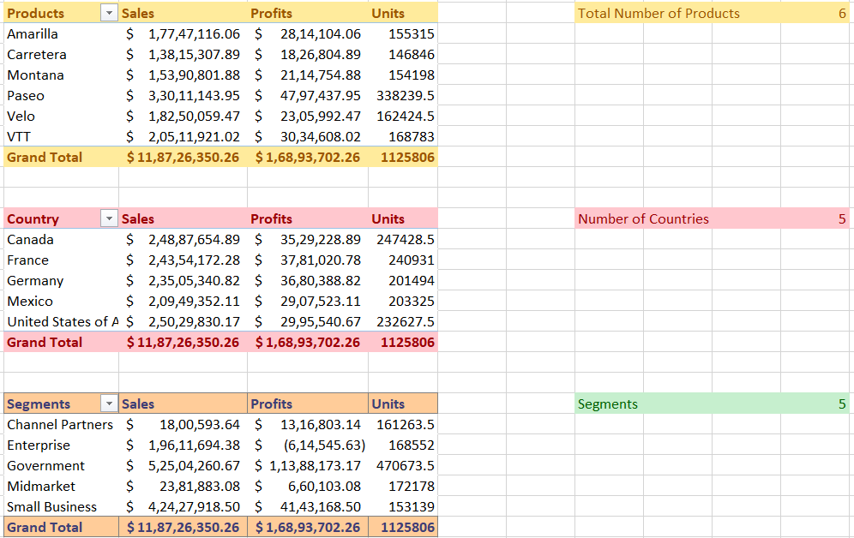
Data Exploration
The dataset captures sales data from various Western countries, detailing transactions across multiple sectors. It includes information on the number of units sold and manufactured, discounts offered, sales amounts, gross sales, and the time and date of each sale. This comprehensive dataset allows for analysis of sales performance, production efficiency, and discount strategies across different regions and sectors, providing valuable insights for business decision-making.

Slide 4
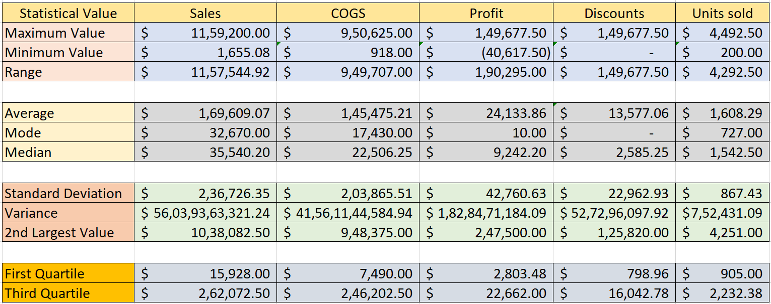
Statistical Analysis using Excel
The statistical analysis of this dataset can provide information regarding a few parameters such as Sales, COGS, Profit, Discounts and Units sold. The extreme values for the parameters were determined, including the average of the entire set, most number of sales per product, and a few other quantities to gain a better understanding of the parameters.

Slide 5
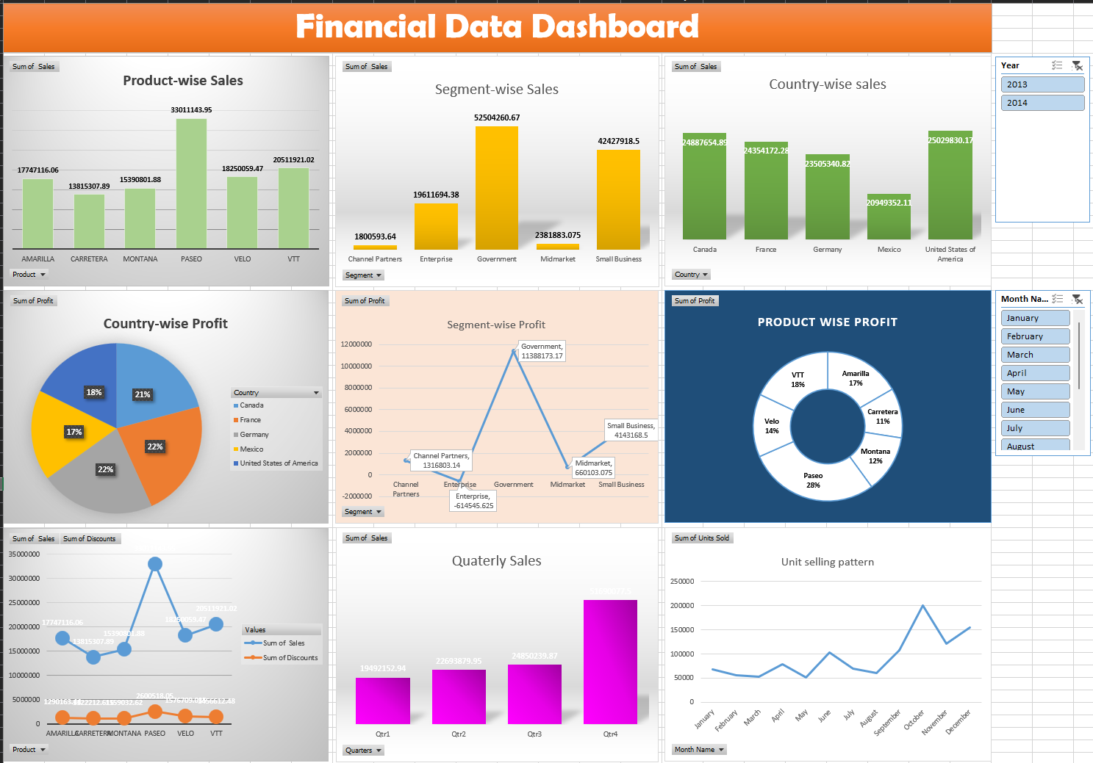
Graphical Analysis using Excel
The Graphical representation illustrates the trends in the total amount of sales varied by products, countries, segments, and also on a specific time period.
We can also observe change in profit trends based on all the categories. Also a pattern indicating the unit sales with respect to the month they are sold in.

Slide 6
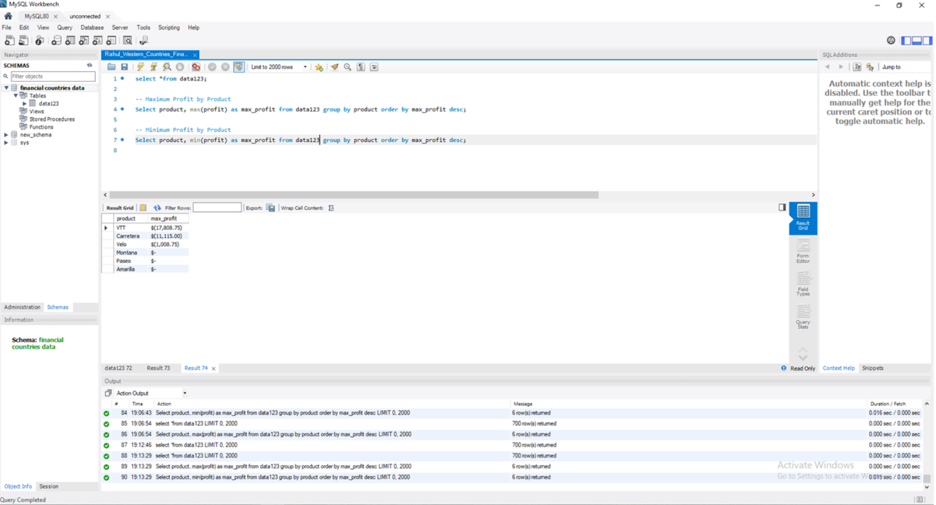
Insert the given data into the SQL server
After inserting the dataset into MySQL Workbench, basic queries are run to attain values such as maximum profit or minimum profit per product type.

Slide 7
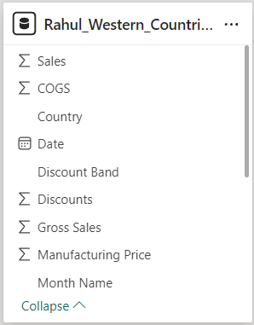
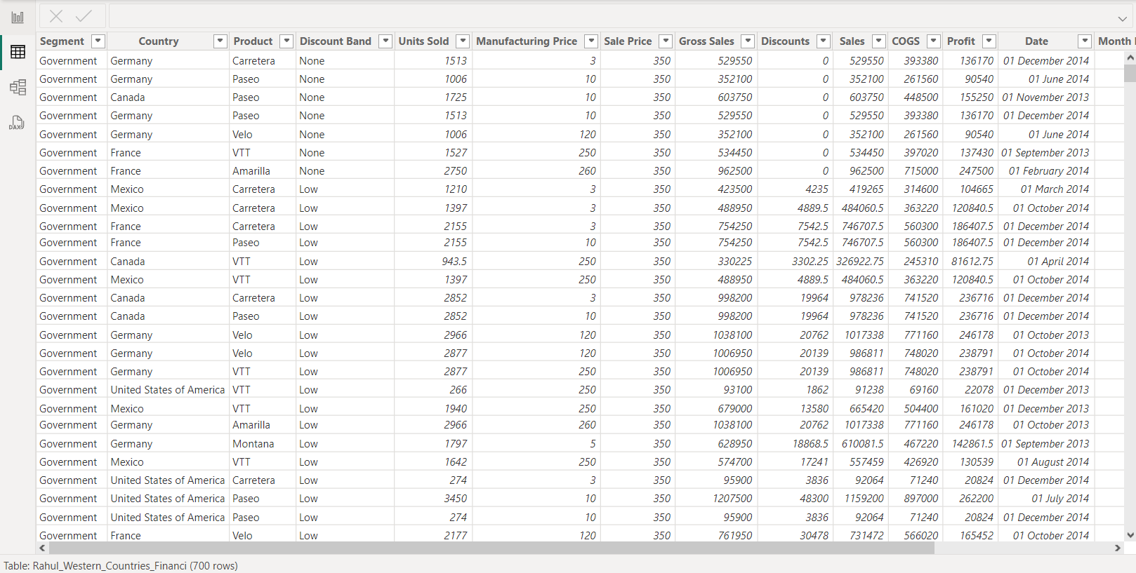
Import the Data from the SQL Database into PowerBI

Slide 8
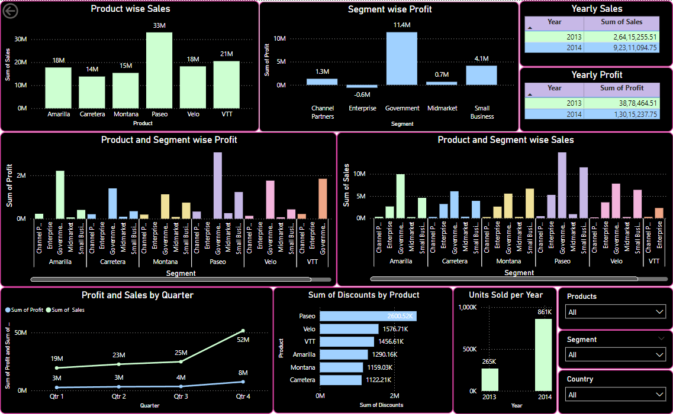
Interactive Dashboard by using visualization tools
A dashboard was prepared by importing the SQL data into PowerBI.
This dashboard can be used to study and understand trends regarding the entire dataset by using few crucial parameters.
Filters were used to make traversing through the dashboard easier as they help in pinpointing specific parameters and only display the selected values and other linked graphs.

Slide 9
Conclusion and Inferences
Based on the Data analysis and visual observations a few things can be clearly stated:
The top 2 countries with the most amount of sales are USA & Canada. But France & Germany take the top2 spot when it comes to profits.
The 3 products that saw the least amount of sales are Carreterra, Montana and Velo in order from least to most.
Almost every country got their most amount of sales from the Government.
There are many more facts can be obtained from the graphs and future trends can be predicted for better business planning, improving profits and also customer retention.

Slide 10
Endnotes
Reference Links:-
The files used in this particular project are added here:
Excel File:
Power BI file:

